Slide 1
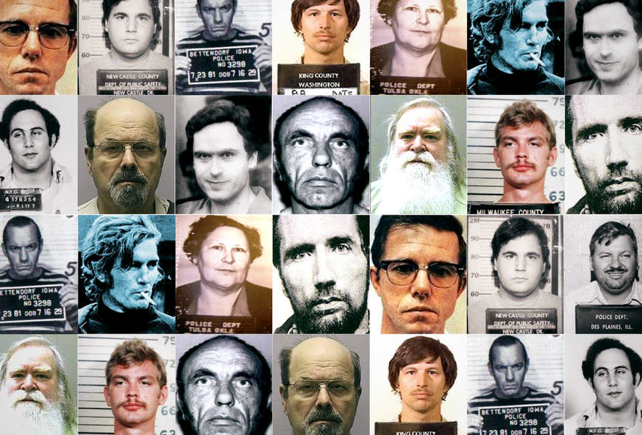
Catching a Serial Killer
Sindhu Kishore | Yudhisteer Chintaram

Slide 2

What is a Serial Murder?
According to the FBI, a serial murder is defined as “unlawful killing of two or more victims by the same offender(s), in separate events”. Though it is a rare event, estimated to comprise less than one percent of all murders committed in a year, serial murder cases present numerous challenges to law enforcement. These cases involve multiple victims, offenders’ behaviour, series may span from days, weeks to months or even years.
Thomas K. Hargrove, a retired investigative journalist and founder of nonprofit Murder Accountability Project said that serial murders go unsolved due to linkage blindness, i.e., the inability of law enforcement to communicate or share information in a way that connects similar unsolved crimes. Although a lot of literature on serial killings exists, the application of data science or any kind of data analysis, is minimal

Slide 3

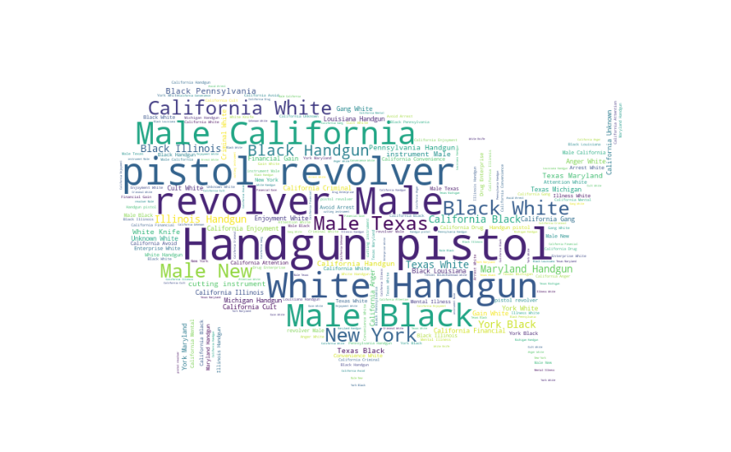
Research Questions
How to identify if a serial killer exists and his pattern of killing?
How to predict a serial killer’s profile?
What led to the decline of serial killers?
Are mass murderers the new facet of serial killers?
The Zodiac Killer still unidentified after 60 years.

Slide 4
Data Source
Public dataset regarding Serial Killers is limited for analysis. We came across Murder Accountability Project (MAP) by Thomas K Hargrove where the data maintained by FBI was made publicly available. We also opted a private resource for our data, the Radford/FGCU Serial Killer Database.
MAP Database:The Murder Accountability Project is a nonprofit group based in Alexandria, Virginia, and operated by a Board of Directors that includes veteran homicide investigators, investigative journalists and homicide scholars. Using the Freedom of Information Act, MAP obtained data on more than 28,200 homicides reported from 1976-2020 with 31 variables per homicide consisting of information about Victim age, sex, location, Weapon etc.
Radford/FGCU serial killer database: A cross-university collaboration of Radford University with Florida Gulf Coast University built this non-governmental private database of serial killers in the world. The database contains 5630 subjects, comprising of serial killers, mass murderers and more. There are over 14773 victims profile, 500 documents and about 185 variables per subject including the background information, victim preference, victim treatment and information about the crimes committed.

Slide 5
How to identify if a serial killer exists and his pattern of killing?

Slide 6
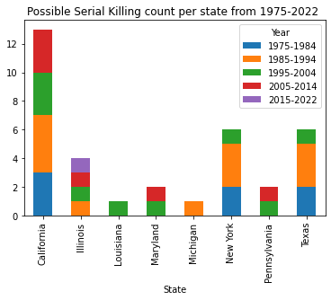
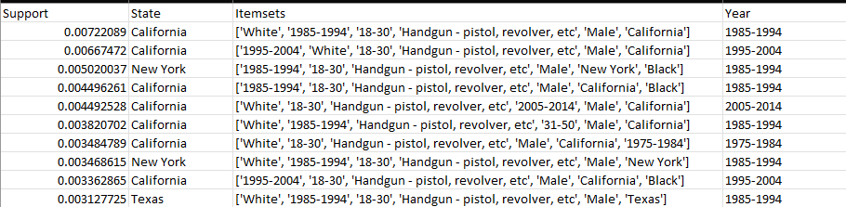
How to identify if a serial killer exists and his pattern of killing?
Murder Accountability Project used only the clustering mechanism to detect if a serial killer exist.
Our approach used frequent pattern mining algorithm to identify if the killing pattern is repeated
We implemented Apriori, fpgrowth and fpmax algorithm on this huge dataset and obtained promising results from fpmax.

Slide 7
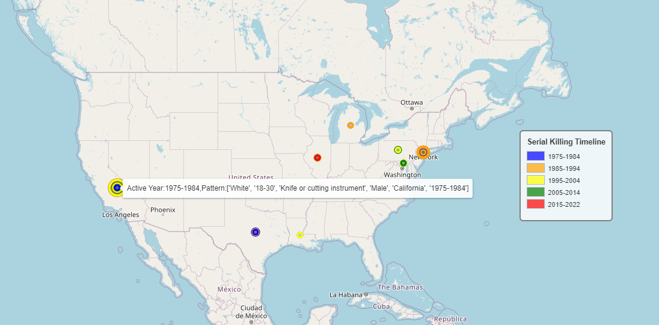
How to identify if a serial killer exists and his pattern of killing?
Frequent pattern obtained from fpmax plotted on USA map
Using minimum support of 0.002, we obtained 35 itemsets containing all the targeted variables.
We observe that California has the maximum serial killing incidents.
Followed by New York, Texas, Illinois, Maryland, Pennsylvania, Michigan and Louisiana.

Slide 8
How to predict a serial killer’s profile?

Slide 9
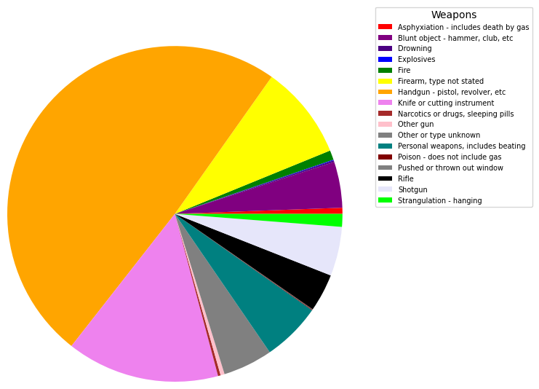
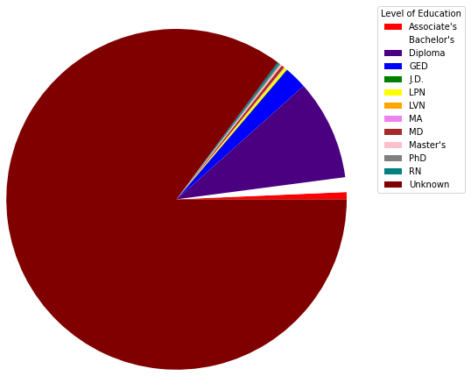
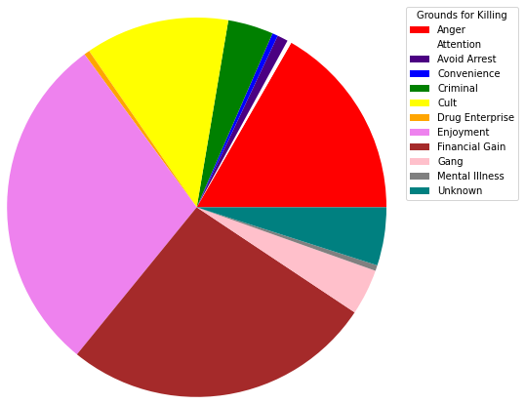
Characteristics of a Serial Killer:
Based on our analysis on Radford and MAP database, we found few interesting characteristics of Serial Killer
A Majority of the Serial Murders had not acquintance or involved in a consensual relationship with their victims.
A serial killer motive may evolve both within a single murder or thorught the series of murder, hence they may have multiple motives for committing the crime.
Though most of the serial killers have little education, successful serial killers possess the cleverness and wit to be able to dispose multiple bodies and outsmart the police leaving no trace of evidence.
Most of the cases involved guns or other type of firearms as weapons.

Slide 10
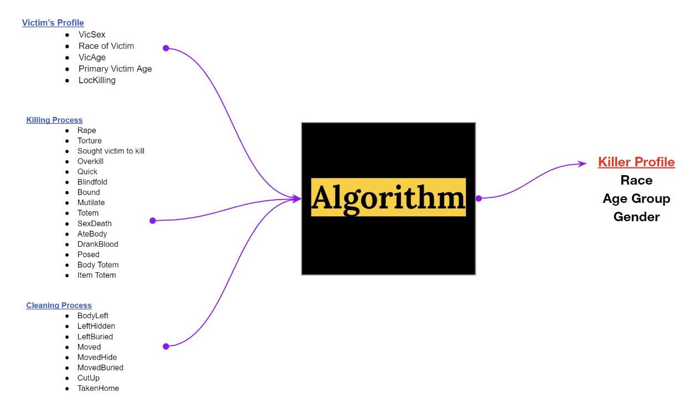
Model
Previous papers only used the victim’s age, gender and race to predict the Killer’s profile.
Our approach is to use the victim’s profile but on top of that use information on how the victims were killed and how the killer managed to cover their traces.
Studies showed that there have been patterns in the killing process and the killer’s profile. For example, a killer who hunt at night is most likely to be unmarried.
Other targets such as Marital Status, Education Level and Sexual Orientation could have been predicted for the killer but the percentage of missing data is too high for data imputation.

Slide 11
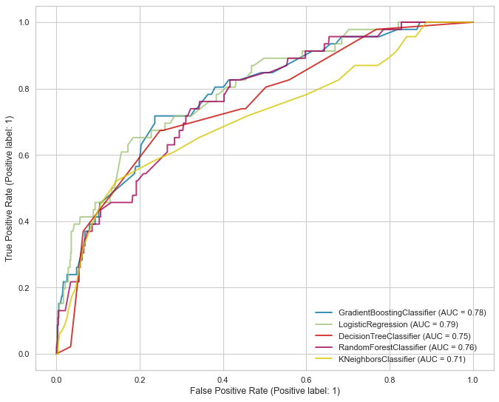
Predicting Killer’s Gender
We have 2 categories of Gender:
0 : Male
1 : Female
Frequent Category Imputation technique used. (< 5% missing data: MAR assumption)
SMOTE technique used as oversampling technique for minority classes.
Stratified K-Fold with 5 splits as Cross-validation technique.
Random forest and KNN has the best accuracy of 94% compared to Logistic Regression with 93%.
Logistic Regression has better AUC score overall.

Slide 12
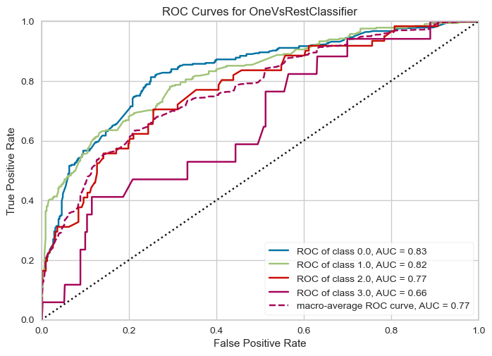
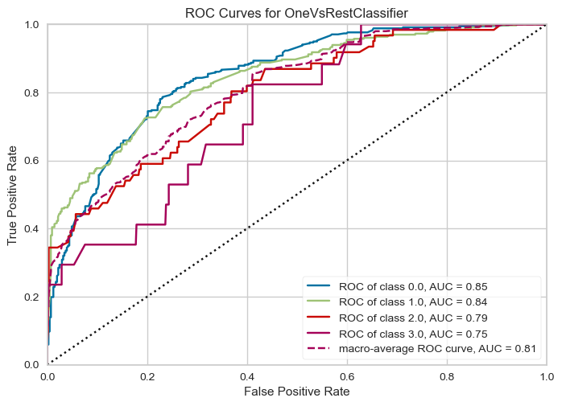
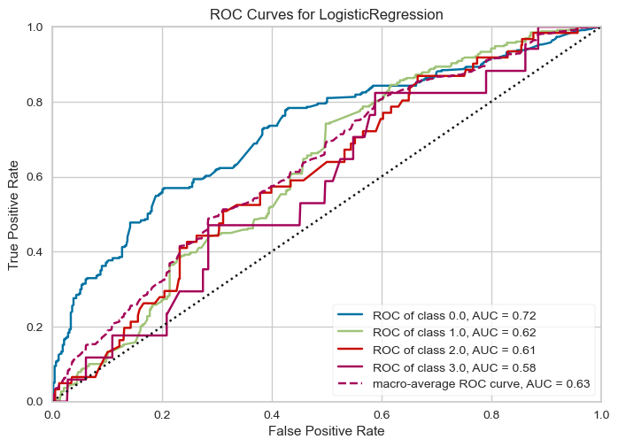
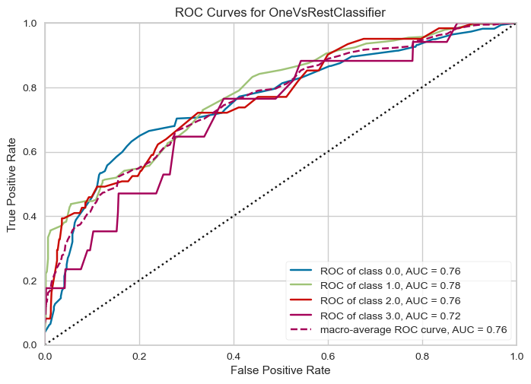
Predicting Killer’s Race
Random Forest
Gradient Boosting
We have 4 categories of Race:
0 : White
1 : Black
2 : Hispanic
3 : Asian, Natives and Others
Frequent Category Imputation technique used. (< 5% missing data: MAR assumption)
SMOTE technique used as oversampling technique for minority classes.
Stratified K-Fold with 5 splits as Cross-validation technique.
Random forest has the best accuracy of 94% compared to Gradient Boosting with 89%.
Gradient Boosting has better AUC score for all the 4 classes.
Logistic Regression
KNN

Slide 13
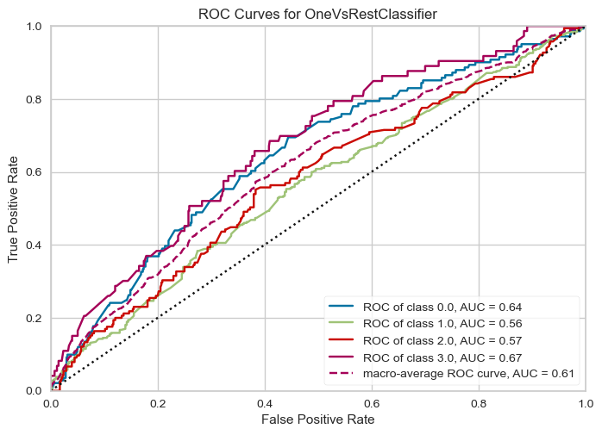
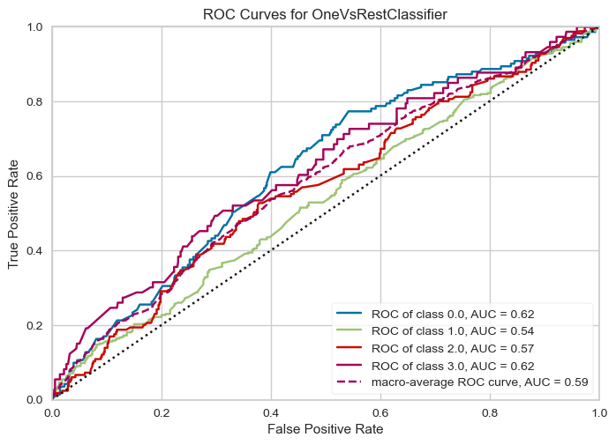
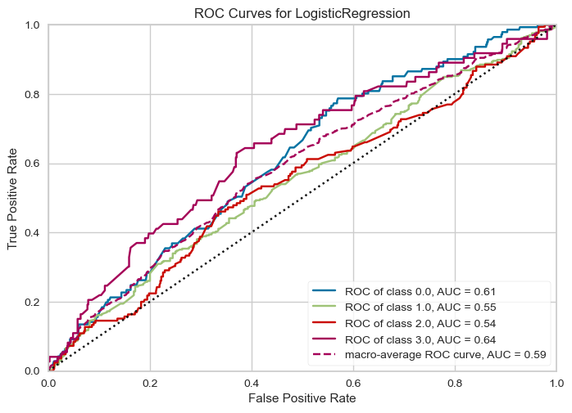
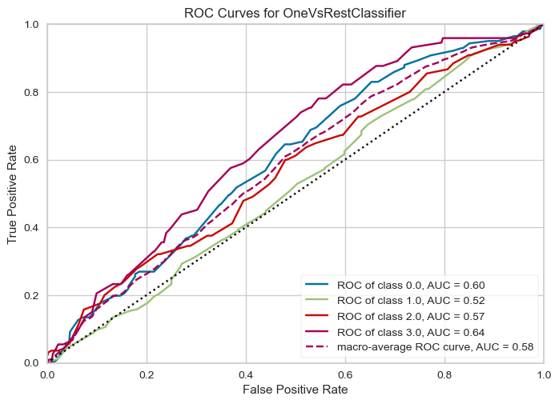
Predicting Killer’s Age Group
Random Forest
Gradient Boosting
We have 4 categories of Age Group:
0 : 10 - 20 years old
1 : 20 - 30
2 : 30 - 40
3 : 40 - 50, 50 - 60, 60 - 70, 70 - 80
Frequent Category Imputation technique used. (< 5% missing data: MAR assumption)
SMOTE technique used as oversampling technique for minority classes.
Stratified K-Fold with 5 splits as Cross-validation technique.
Gradient Boosting has the best balanced accuracy of 33% compared to Gradient Boosting with 31%.
Random forest has better AUC score of 0.61.
Logistic Regression
KNN

Slide 14
What led to the decline of serial killers?

Slide 15
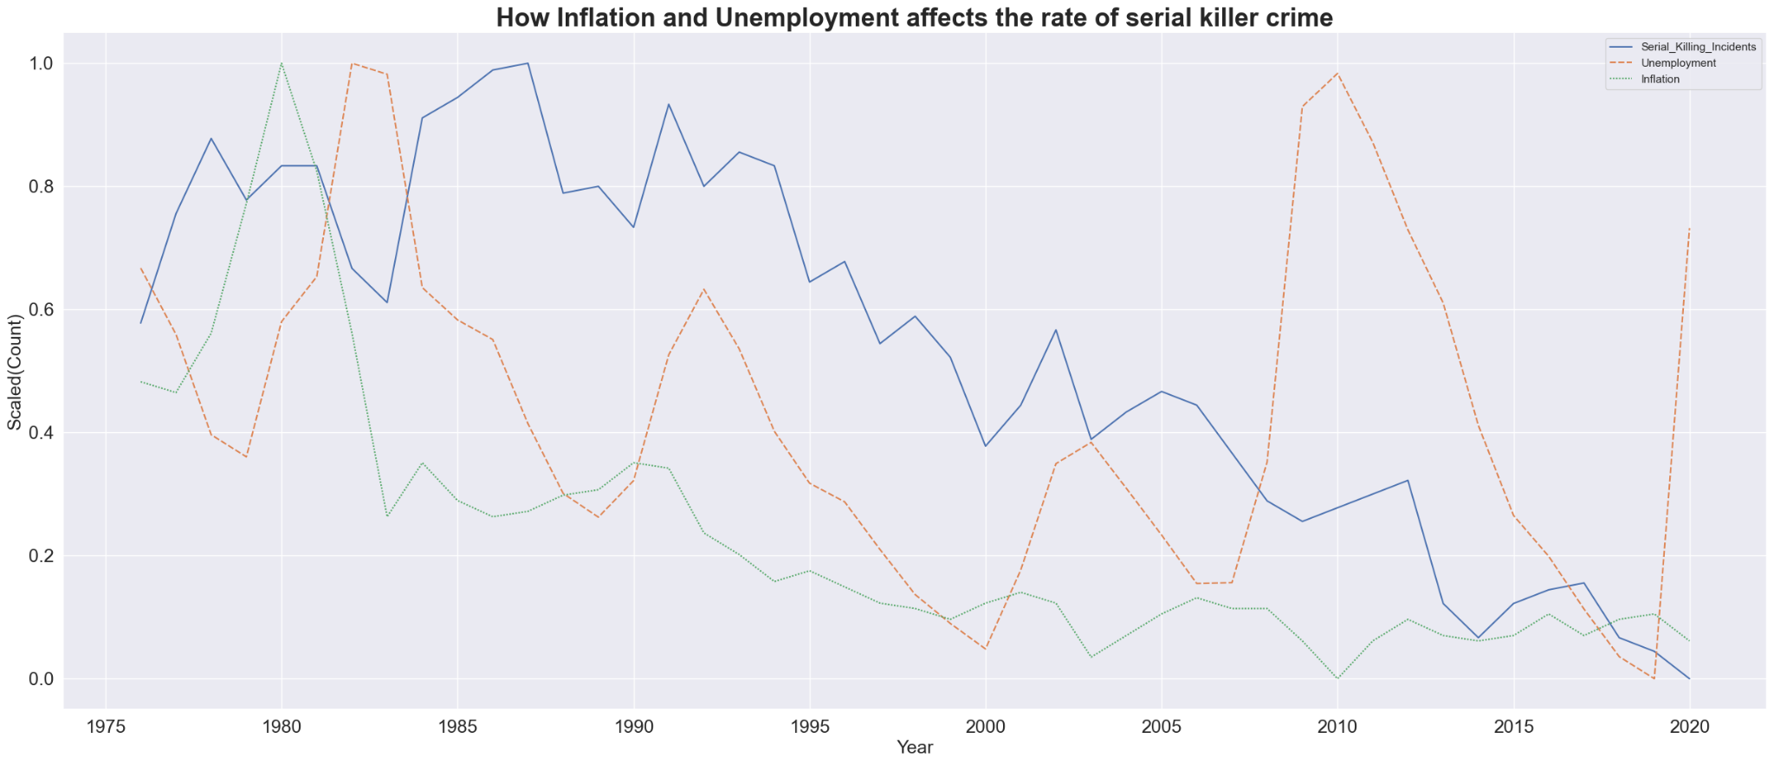
What led to the decline of serial killers?
Overall, the number of incidents by serial killers had been on the decline.
Granger causality test was used to check if Inflation or Unemployment can be used to predict the number of incidents. Note that a predictive relationship does not imply a causal relationship.
P-value is not significant for number of incidents and Unemployment. But p-value is significant for number of incidents and Inflation rate at lag 2 and 5.
We can also observe from the graph that both inflation and the number of incidents has a similar decreasing trend.
Data Source: 1. U.S Bureau of Labor Statistics
2. Radford/FGCU Serial Killer Database

Slide 16
Are mass murderers the new facet of serial killers?

Slide 17
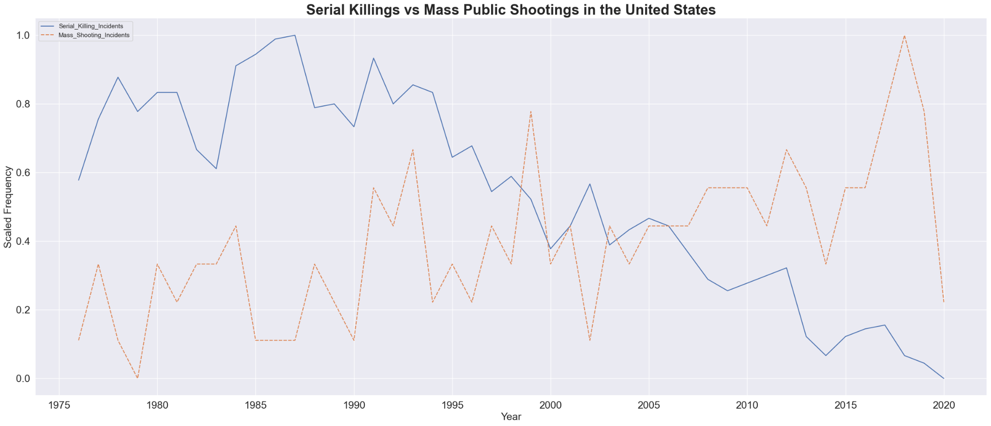
Are mass murderers the new facet of serial killers?
The number of serial killer and mass shooting incidents were filtered from 1976 to 2020.
As the number of serial killer incidents has been on the decline, the number of mass public shootings has been increasing.
Part of the reason for the rise of mass shootings is due to the ease of availability of guns and lack of gun control in the U.S.
We can confidently conclude that we now have less serial killing incidents than mass public shooting incidents. The current laws, culture and environment is giving birth to more mass shooting murderers.
Data Source: 1. The Violence Project: Mass Public Shootings in the United States, 1966–2022
2. Radford/FGCU Serial Killer Database

Slide 18
Conclusion
California has the most total victims (1,628), but it also has the largest population of any US state.
Across race lines, two-thirds of serial killer victims are white. But when gauged with US Census, black people account for a whopping 24 percent of all victims.
Gender-wise, victims are essentially split down the middle, with a slight lean toward women.
More than half of all serial killer victims are below the age of 30.
The majority of serial killers simply kill for enjoyment.
If we pursue this study further we plan on predicting more features of the killer like IQ, family background etc. In our current approach we predict the age group of the killer this can be further improved by predicting the right age.

